Slide 1

English for Telephoning
Class: 18C1-NNA1
Time: 14.10 – 15.40 on
Lecturer: Ms. Nguyen Thi Thanh Tu
Faculty of Foreign Languages
Ly Tu Trong College of Ho Chi Minh City
Unit 6: How does that sound?

Slide 2
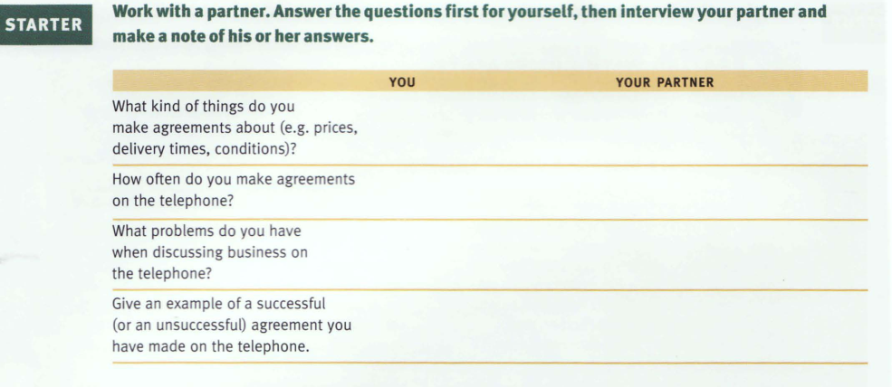

Slide 3
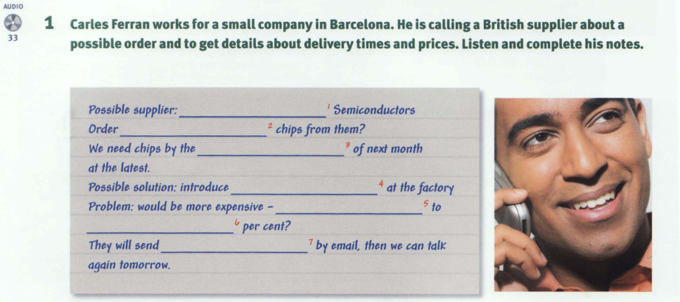

Slide 4
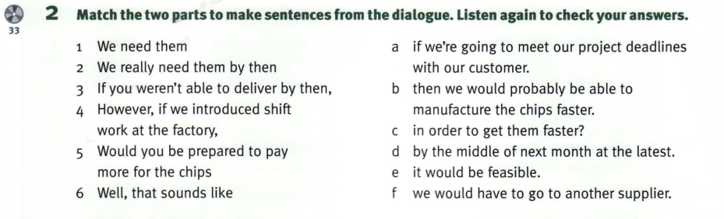

Slide 5
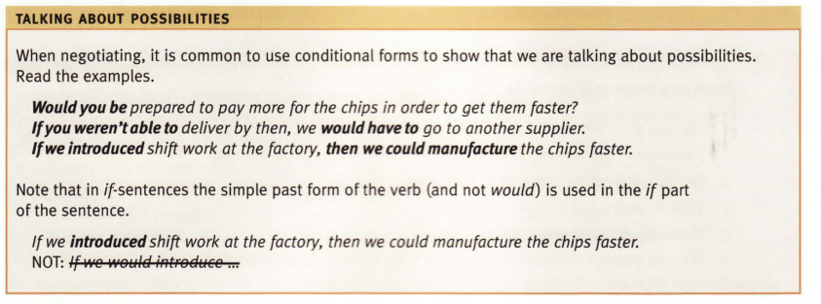

Slide 6

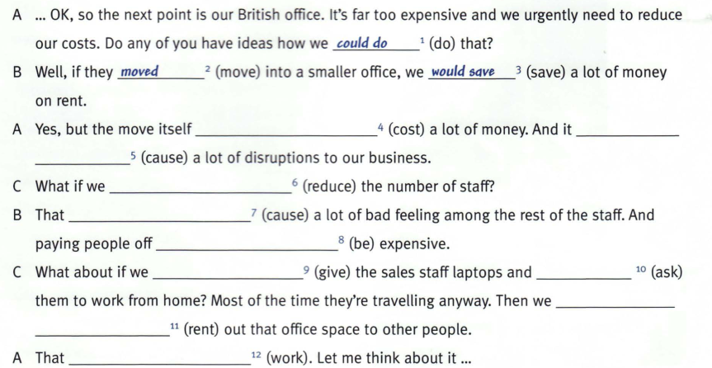

Slide 7
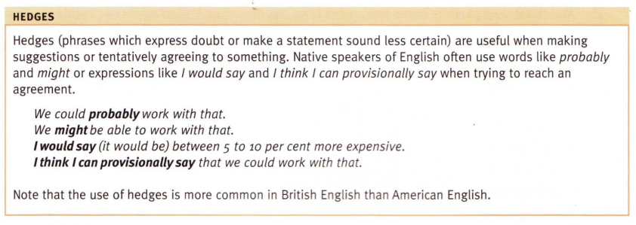

Slide 8
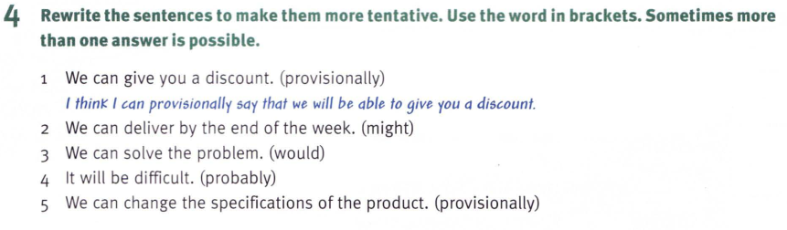

Slide 9
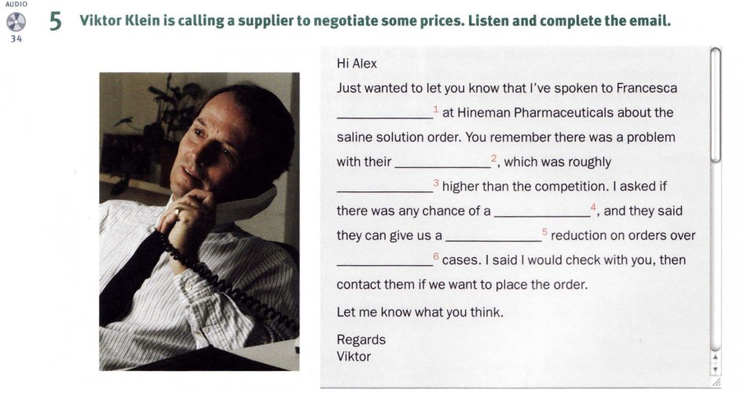

Slide 10
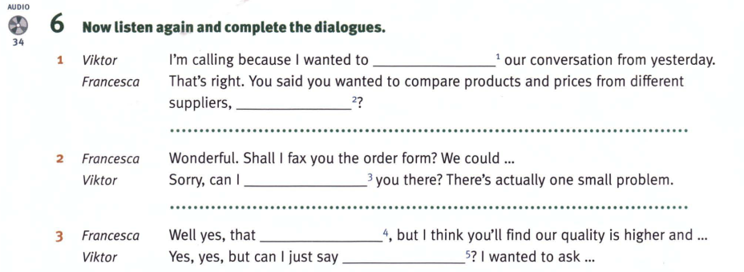

Slide 11
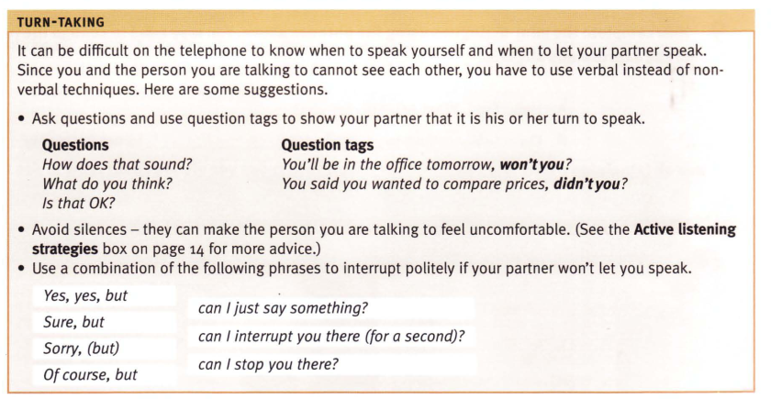

Slide 12
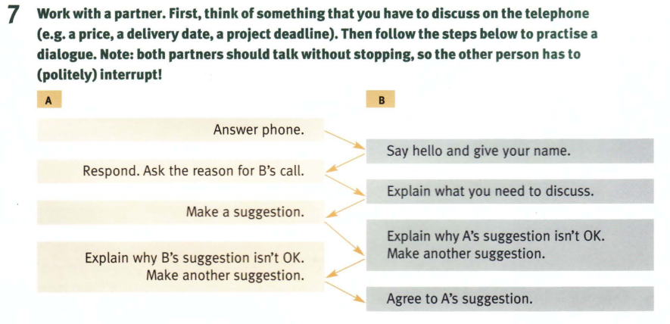

Slide 13
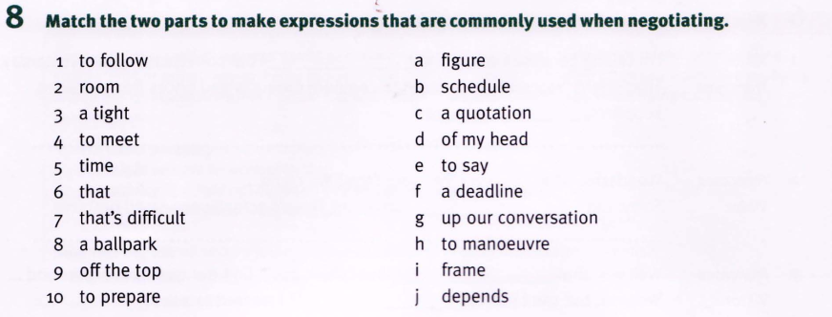

Slide 14
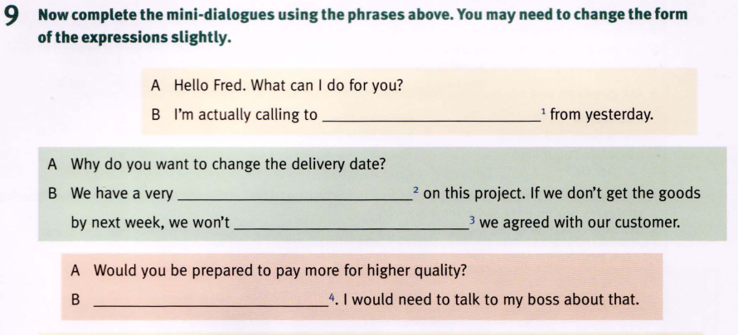

Slide 15
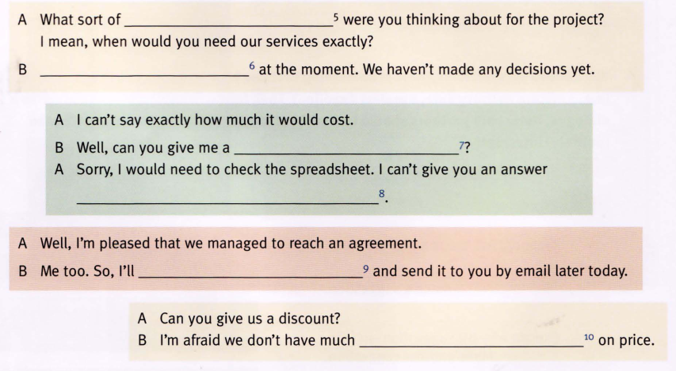

Slide 16
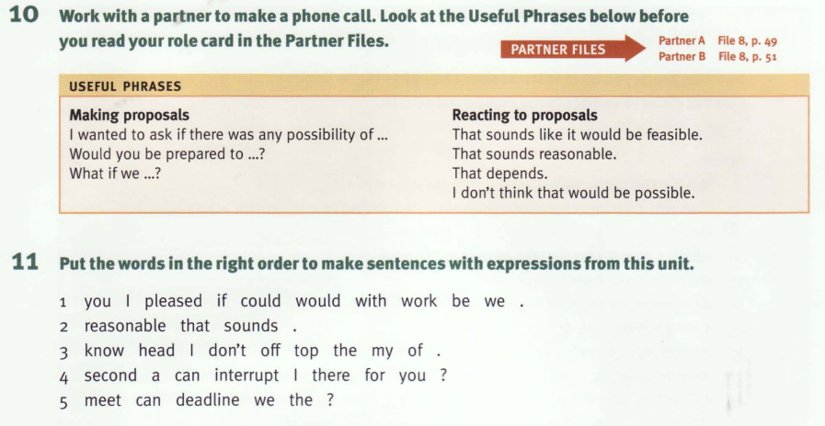

Slide 17
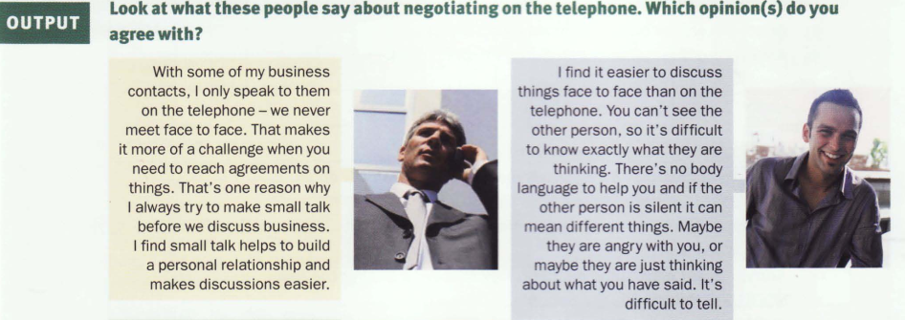

Slide 18
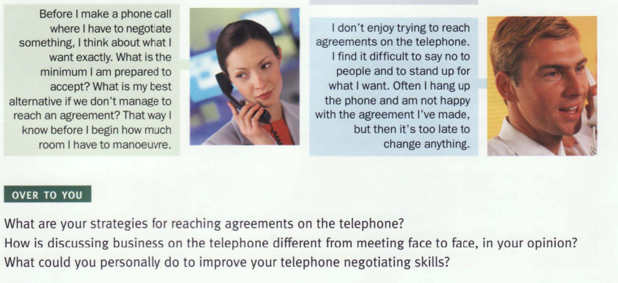

Slide 19
Homework:
After these two periods you have to learn all vocabulary.
Review for final test

